Slide 1




AI/ML

Slide 2

Learning Objectives
The objective of this project is to develop a Crop and Fertilizer Recommendation System using Machine Learning to help farmers make data-driven decisions. By analyzing soil properties, weather conditions, and crop requirements, the system will suggest the most suitable crops and optimal fertilizer types to enhance yield and sustainability.
GOAL

Slide 3
Tools and Technology used
This project utilizes Machine Learning techniques to develop a Crop and Fertilizer Recommendation System. The key tools used include Python and libraries such as NumPy, Pandas, Matplotlib, and Seaborn for data preprocessing, visualization, and analysis. Scikit-learn is leveraged for model building, including Decision Tree Classifier for fertilizer prediction and Random Forest Classifier for crop recommendation. The dataset is processed using Label Encoding and Standard Scaling to ensure consistency in numerical features.
Additionally, the model is trained using train-test split to evaluate performance. The Decision Tree Classifier is used for fertilizer recommendation based on soil nutrients and environmental conditions, while the Random Forest Classifierpredicts the best-suited crop. Performance is assessed using accuracy scores, classification reports, and confusion matrices to ensure reliable predictions

Slide 4
Methodology
This Machine Learning-based system analyzes soil and environmental factors to recommend the best crop and fertilizer, ensuring optimal yield and sustainability.
Steps in the Methodology:
Import Libraries: Use NumPy, Pandas, Matplotlib, Seaborn, and Scikit-learn for data processing and visualization.
Load & Explore Data: Perform EDA, check for missing values, duplicates, and statistical summaries.
Data Preprocessing: Encode categorical variables (Label Encoding) and normalize numerical data (StandardScaler).
Feature Selection: Analyze correlations using heatmaps to identify key influencing factors.
Model Training:
Decision Tree Classifier for fertilizer recommendation.
Random Forest Classifier for crop recommendation.
Model Evaluation: Assess performance using accuracy scores and confusion matrices.
Prediction Function: Accepts input conditions and provides the best fertilizer and crop recommendations.
Advantages of the Model: Data-Driven Decisions – Enhances agricultural planning. Improved Accuracy – Machine learning ensures precise recommendations. Automation & Efficiency – Saves time and boosts productivity.

Slide 5
Problem Statement for AI/ML -
Develop a Machine Learning model to recommend the best crop and fertilizer based on soil, weather, and nutrient conditions, helping farmers optimize yield and resource use.

Slide 6
Solution:
The Machine Learning-based Crop and Fertilizer Recommendation System processes soil, weather, and nutrient data to provide accurate recommendations. Decision Tree Classifier predicts fertilizers, while Random Forest Classifier recommends crops. Feature scaling, encoding, and correlation analysis improve model performance, ensuring efficient and data-driven agricultural decision-making.

Slide 7
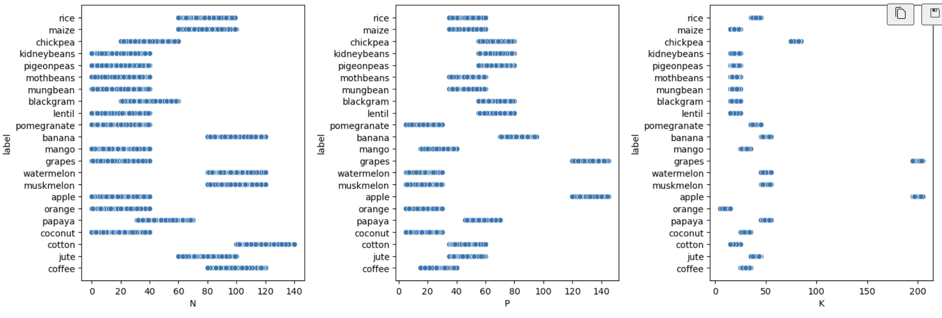
Output Screenshots
1

Slide 8
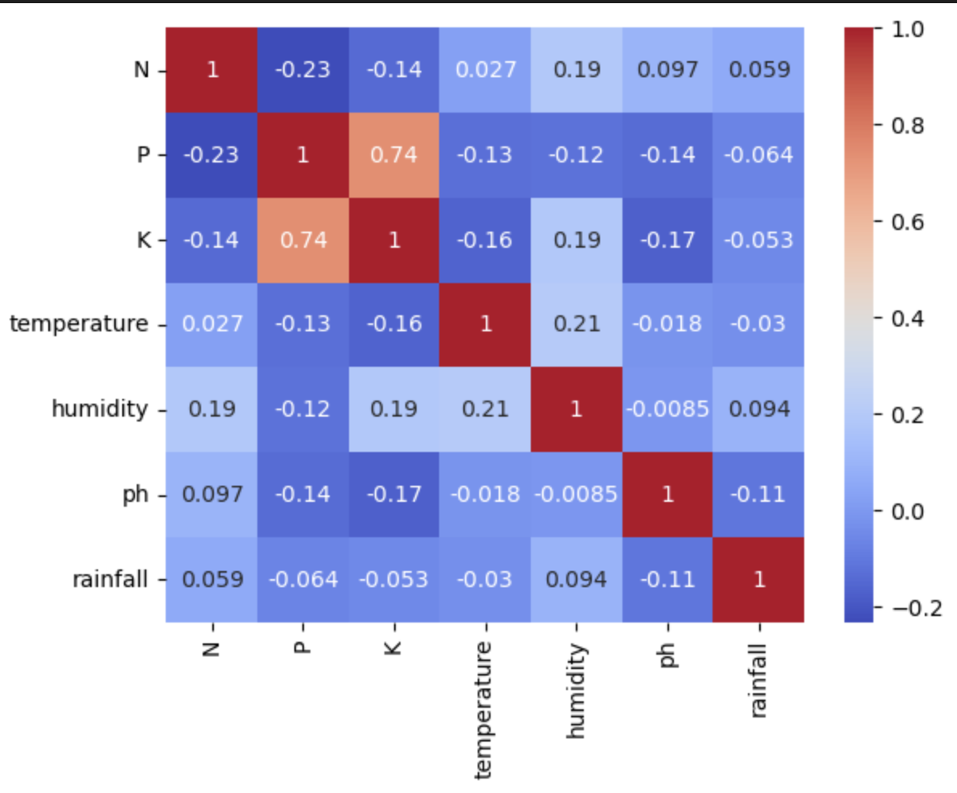
Output Screenshots
2

Slide 9
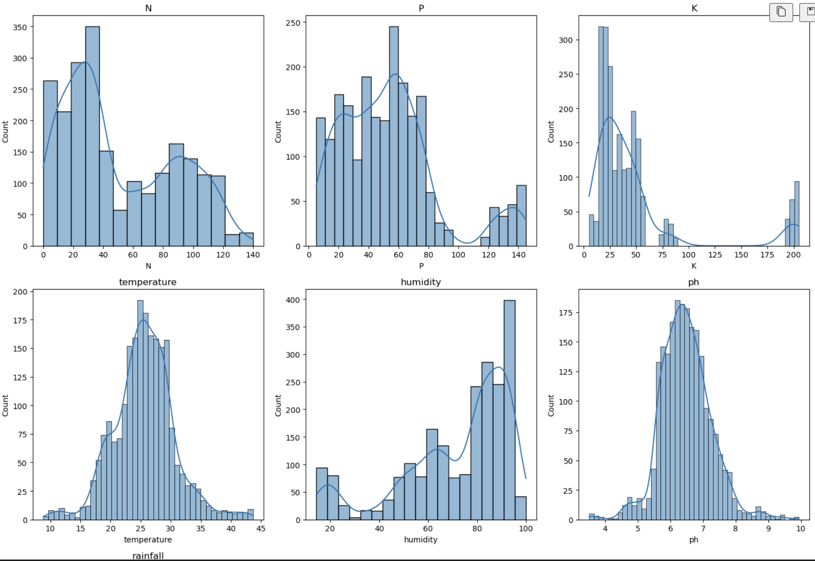
Output Screenshots
3

Slide 10
Conclusion:
The Crop and Fertilizer Recommendation System is a powerful Machine Learning solution that enhances agricultural decision-making. By analyzing soil composition, weather conditions, and nutrient levels, the system provides accurate recommendations, helping farmers increase productivity, optimize fertilizer use, and promote sustainable farming.
This system can be applied in precision agriculture, smart farming, and large-scale crop management. Future improvements can include more advanced models, integration with IoT sensors, and real-time data updates to enhance accuracy and adaptability. Expanding the dataset and incorporating deep learning techniques can further refine recommendations, making agriculture more efficient and data-driven.

